Slide 1

Computer Network
Sabbir Hossen
Lecturer
Department of CSE
City University
Email: sabbirhossen00@gmail.com
LinkedIn: https://www.linkedin.com/in/sabbir-hossen-71181115a
No: 01757007366 (Emergency Call)
Notes:
1.#

Slide 2

Chapter 1
Introduction
Sabbir Hossen
Notes:
1.#

Slide 3
Data Communication:
The term telecommunication means communication at a distance. Data communications are the exchange of data between two devices via some form of transmission medium such as a wire cable.
Sabbir Hossen
Notes:
1.#

Slide 4
Data Representation:
Numbers
  8/16/32 bit integers
  floating point
Text
  ASCII, Unicode
Images
  Bit patterns, Graphics formats JPG/GIF/etc
Audio → Samples of continuous signal
Video → Sequence of bitmap images
Sabbir Hossen
Notes:
1.#

Slide 5
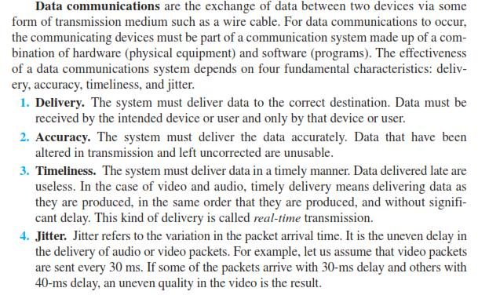
Data Communication Characteristic
Sabbir Hossen
Notes:
1.#

Slide 6
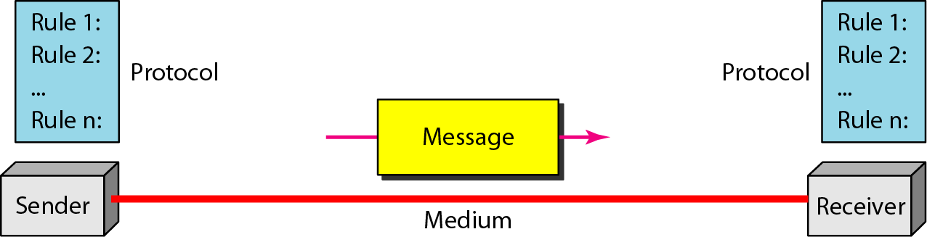
Components of a data communication system
Sabbir Hossen
Notes:
1.#

Slide 7
Direction of Data Flow
Simplex: One direction only
data flow
Server
Monitor
data flow
Keyboard
Sabbir Hossen

Slide 8
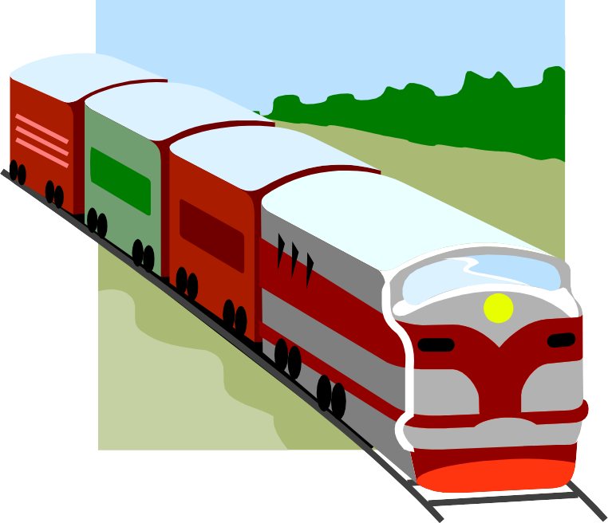
Direction of Data Flow
Half Duplex: Both directions, one at a time
walkie-talkies
data flow at time 1
data flow at time 2
Sabbir Hossen

Slide 9

Direction of Data Flow
Full Duplex: Both directions simultaneously
  Telephone
Can be emulated on a single communication link using various methods
data flow
data flow
Sabbir Hossen

Slide 10
Networks:
A network is a set of devices (often referred to as nodes) connected by communication links. A node can be a computer, printer, or any other device capable of sending and/or receiving data generated by other nodes on the network. A link can be a cable, air, optical fiber, or any medium which can transport a signal carrying information.
Sabbir Hossen
Notes:
1.#

Slide 11
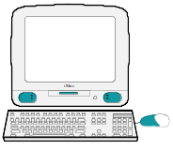
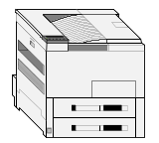
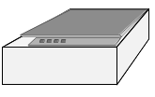
Networks:
Laptop
Workstation
Media Links
Server
Scanner
Printer
Sabbir Hossen

Slide 12
Physical Structures
Type of Connection:
  Point to Point - single transmitter and receiver
  Multipoint - multiple recipients of single transmission
Physical Topology-Connection of devices
  Type of transmission - unicast, multicast, broadcast
Sabbir Hossen
Notes:
1.#

Slide 13
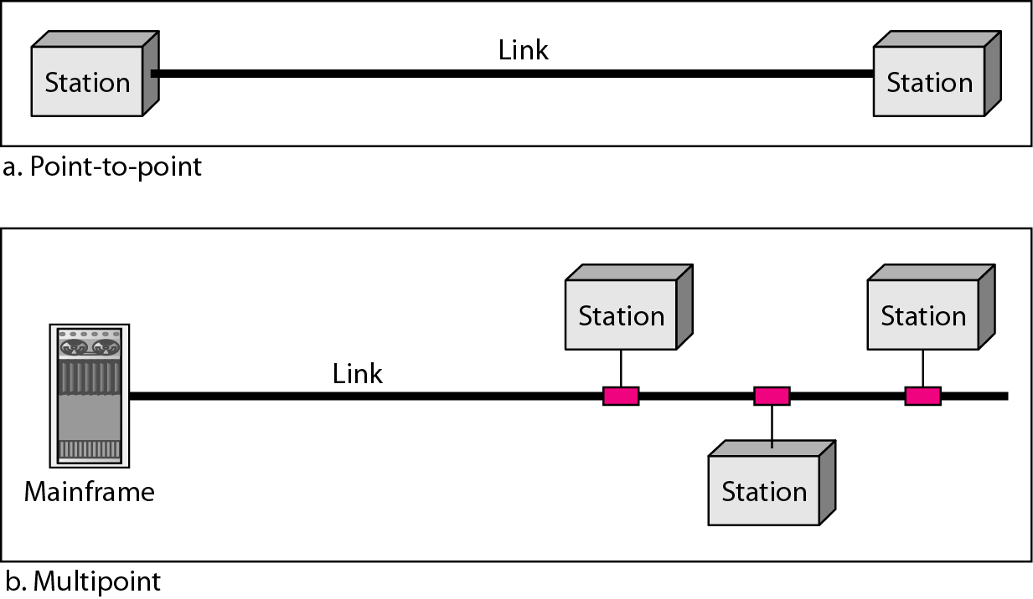
Types of connections: point-to-point and multipoint
Sabbir Hossen
Notes:
1.#

Slide 14
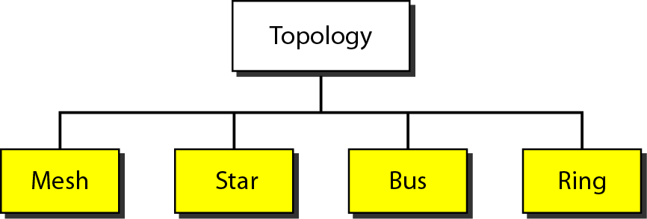
Topology
Sabbir Hossen
Notes:
1.#

Slide 15
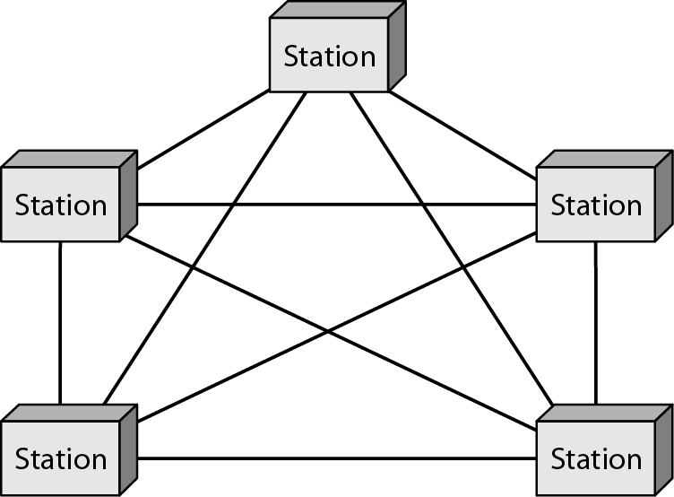
Mesh Topology:
Sabbir Hossen
Notes:
1.#

Slide 16
Advantages and Disadvantage:
Pros:
  Dedicated links
  Robustness
  Privacy
  Easy to identify fault
  Cons:
  A lot of cabling
  I/O ports
  Difficult to move
  Example: Zigbee, WAN, Telephone Office
Sabbir Hossen

Slide 17
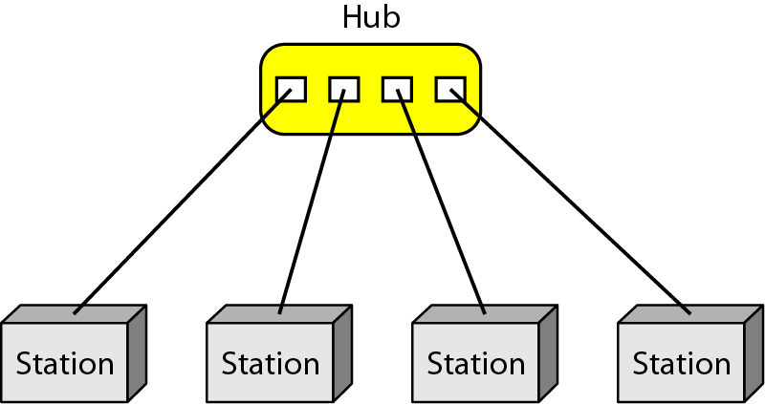
Star Topology
Sabbir Hossen
Notes:
1.#

Slide 18
Advantages and Disadvantage:
Pros:
  Dedicated links
  Robustness
  Privacy
  Easy to identify fault
Cons:
  A lot of cabling
  I/O ports
  Difficult to move
  Example: LAN
Sabbir Hossen

Slide 19
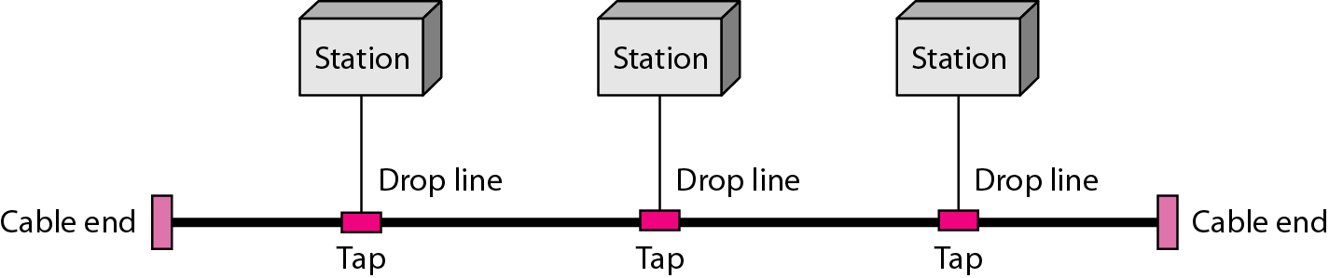
Buss Topology:
Sabbir Hossen
Notes:
1.#

Slide 20
Advantages and Disadvantage:
Pros:
  Little cabling
  Easy to install
Cons:
  Difficult to modify
  Difficult to isolate fault
  Break in the bus cable stops all transmission
  Example: Most of the computer MotherBoard
Sabbir Hossen

Slide 21
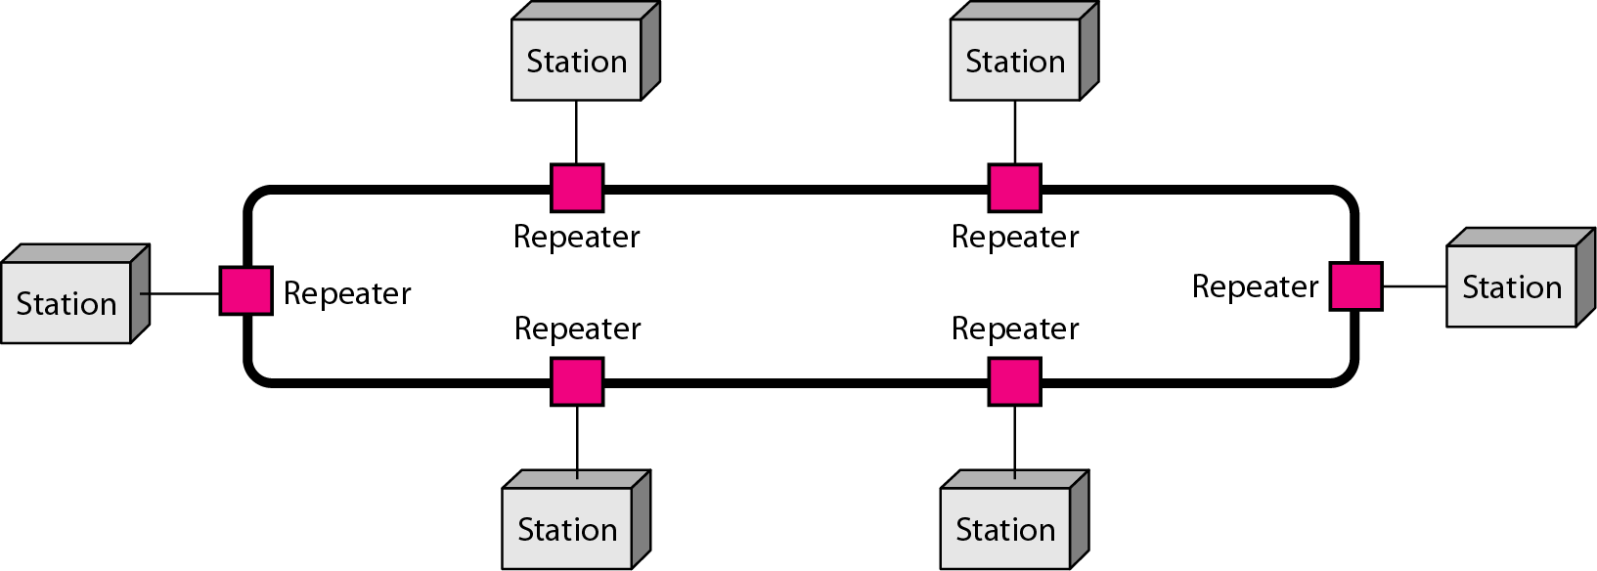
Ring Topology:
Sabbir Hossen
Notes:
1.#

Slide 22
Advantages and Disadvantage:
Pros:
  Little cabling
  Easy to install
Cons:
  Difficult to modify
  Difficult to isolate fault
  Break in the bus cable stops all transmission
  Example: Office or School
Sabbir Hossen

Slide 23
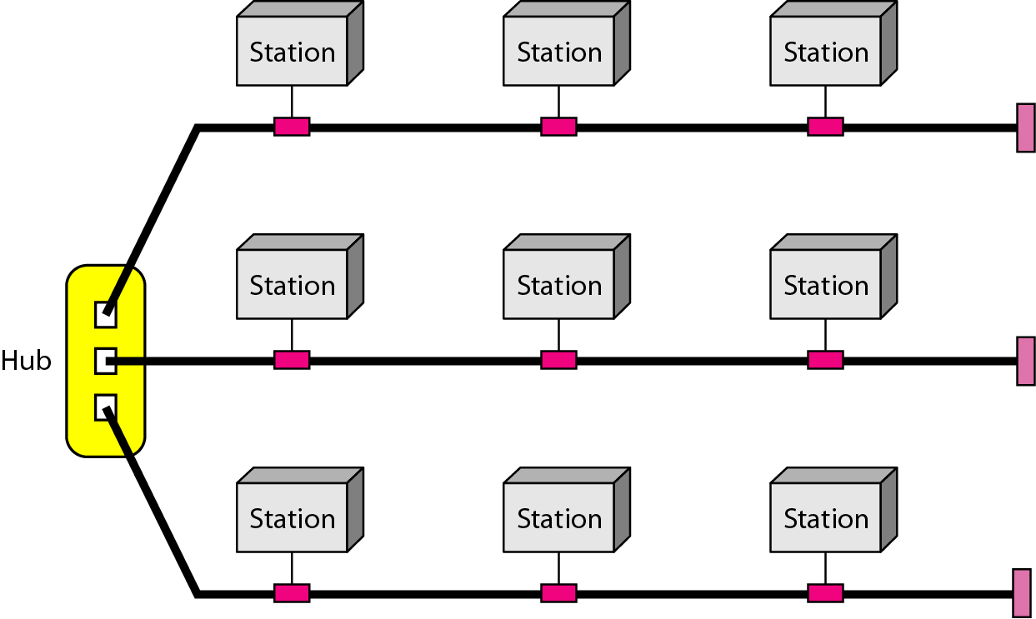
Hybrid topology: A star backbone with three bus networks
Sabbir Hossen
Notes:
1.#

Slide 24
Categories of Networks:
Local Area Networks (LANs)
  Short distances
  Designed to provide local interconnectivity
Wide Area Networks (WANs)
  Long distances
  Provide connectivity over large areas
Metropolitan Area Networks (MANs)
  Provide connectivity over areas such as a city, a campus
Sabbir Hossen
Notes:
1.#

Slide 25
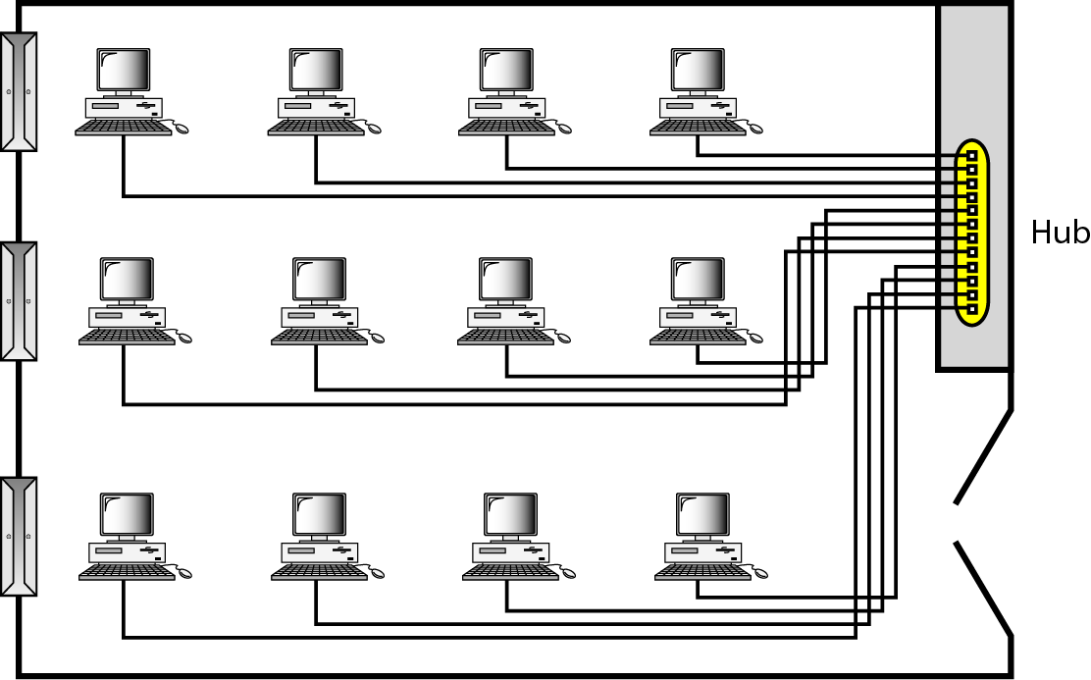
An isolated LAN connecting 12 computers to a hub in a closet
Example: Single Office , Building or School
Sabbir Hossen
Notes:
1.#

Slide 26
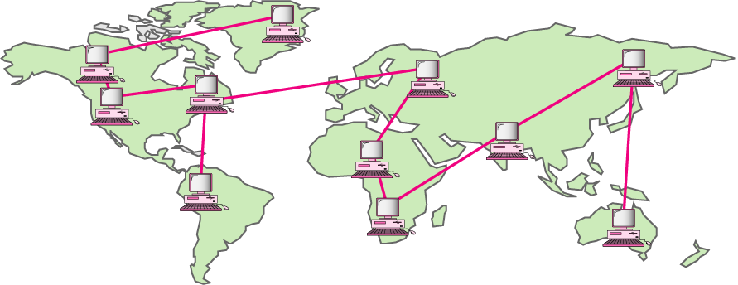
WANs
Sabbir Hossen
Notes:
1.#

Slide 27




Metropolitan Area Networks:
Network extended over an entire city
Barisal
Patuakhali
Sabbir Hossen

Slide 28
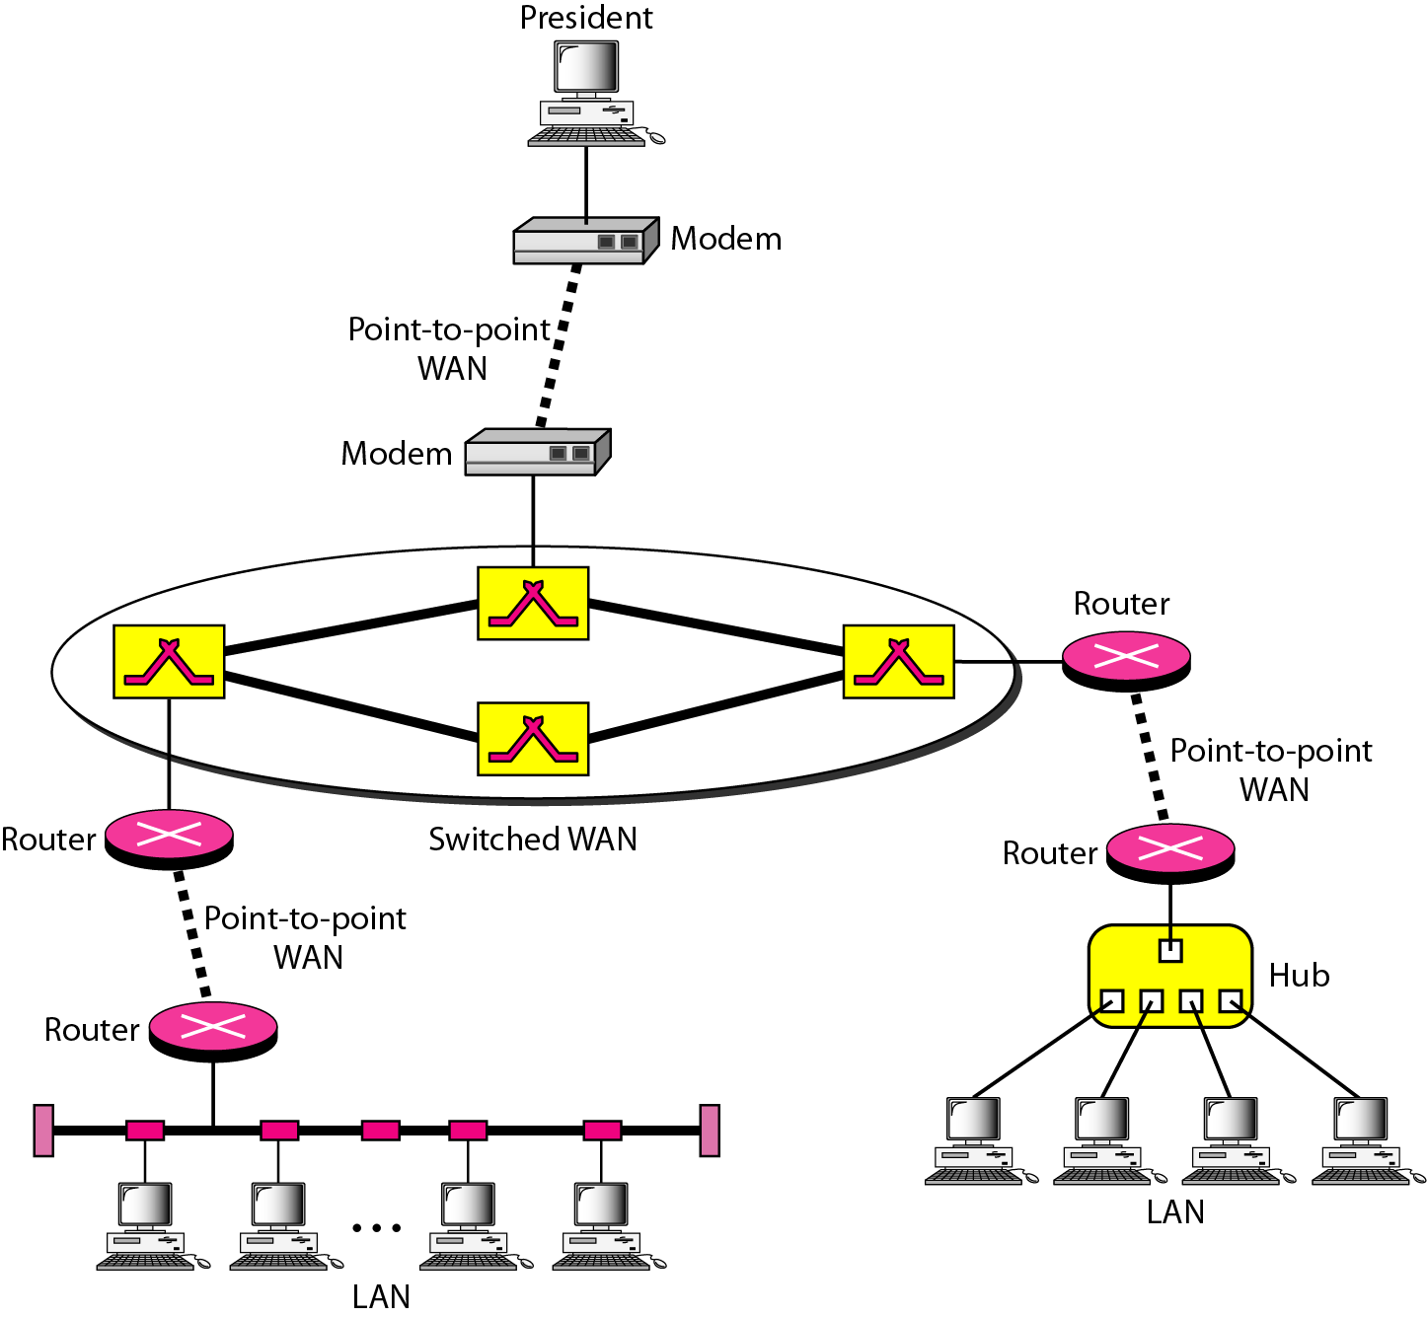
A heterogeneous network made of four WANs and two LANs
Sabbir Hossen
Notes:
1.#

Slide 29
Internetworks:
Two or more networks connected become an internetwork, or internet
Example: The Internet
Network1
Network2
Gateway
Network3
Sabbir Hossen

Slide 30
The Internet:
The largest internetwork (network of networks) in the world
Devices communicating with TCP/IP protocol suite
Stanford
U. of Utah
UC Santa Barbara
UCLA
Sabbir Hossen

Slide 31
The Internet:
The Internet has revolutionized many aspects of our daily lives. It has affected the way we do business as well as the way we spend our leisure time. The Internet is a communication system that has brought a wealth of information to our fingertips and organized it for our use.
Sabbir Hossen
Notes:
1.#

Slide 32
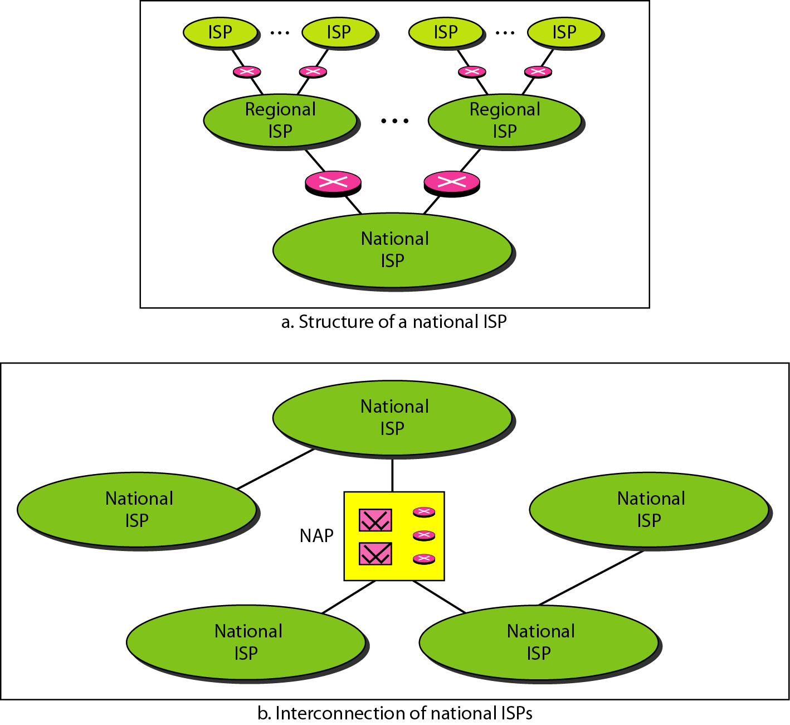
Hierarchical organization of the Internet
Sabbir Hossen
Notes:
1.#

Slide 33


Switching:
Circuit switching
  Telephone switches
  establish circuits
  for communication
Packet switching
  Data are put into
  packets
  Each stamped with
  source and destination
  addresses
  Routers know where to
  forward packets
telephone
switch
Packet
Router
Sabbir Hossen

Slide 34
Circuit Switching | Packet Switching
In-circuit switching has there are 3 phases: i) Connection Establishment. ii) Data Transfer. iii) Connection Released. | In Packet switching directly data transfer takes place.
In-circuit switching, each data unit knows the entire path address which is provided by the source. | In Packet switching, each data unit just knows the final destination address intermediate path is decided by the routers.
In-Circuit switching, data is processed at the source system only | In Packet switching, data is processed at all intermediate nodes including the source system.
Circuit switching is more reliable. | Packet switching is less reliable.
Wastage of resources is more in Circuit Switching | Less wastage of resources as compared to Circuit Switching
It is not a store and forward technique. | It is a store and forward technique.
Transmission of the data is done by the source. | Transmission of the data is done not only by the source but also by the intermediate routers.
In-Circuit Switching there is a physical path between the source and the destination | In Packet Switching there is no physical path between the source and the destination
Sabbir Hossen

Slide 35
Protocol
A protocol is a set of rules that govern data communications. It determines what is communicated, how it is communicated and when it is communicated. The key elements of a protocol are syntax, semantics and timing
Sabbir Hossen
Notes:
1.#

Slide 36
Elements of a Protocol
Syntax
  Structure or format of the data
  Indicates how to read the bits - field delineation
Semantics
  Interprets the meaning of the bits
  Knows which fields define what action
Timing
  When data should be sent and what
  Speed at which data should be sent or speed at which it is being received.
Sabbir Hossen
Notes:
1.#

Slide 37
Hub | Switch | Router
Work on physical Layer | Work on data link layer | Work on network layer
Layer 1 | Layer 2 | Layer 3
Half duplex | Full duplex
Work on the basis of MAC address | Work on the basis of IP address | Work on the basis of IP address
Data Transmission is electrical signals or bits | Data Transmission is frame or packets | Data Transmission is based on protocol
Used in LAN | Used in LAN | Used in LAN / WAN
Sabbir Hossen

Slide 38
References:
B.A. Forouzan, Data Communications and Networking, 4 rd. Edition.
https://www.tutorialspoint.com/data_communication_computer_network/index.htm
Sabbir Hossen

